Slide 1
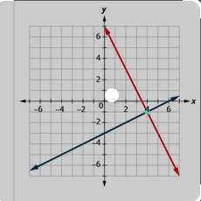
SOFTWARE PROJECT LAB-1
Project Name: Equation Solver
Presented by: Supervised by:
Sakib Al Hasan Dr. Naushin Nower
Roll: BSSE1209

Slide 2
Motivation of the project
Equation is the part of educational life.
Solving the large equation is very tough for humans.

Slide 3
Overview
This project solve three types of equation.
Linear algebra
Linear programming
Polynomial equation

Slide 4

Scope
Find a maximum and minimum value for linear programming and also find critical points.
Solve the polynomial equation and try to find real and rational roots.
Users can Input the whole equation or input coefficient of the equation.
Input linear equation and it will find the solution if exists.
Also, detect if infinitely many solution or no solution exists.

Slide 5
Why efficient (user perspective)
No need to arrange equations in standard form.
No need to count the number of variables.
It can detect is there no solution or infinitely many solutions.
No need to input a fixed variable name.

Slide 6

Progress so far
Input any kind of linear equation and it will give solutions.
Input coefficient of the equation.
Detect if there are infinitely many solutions or no solution exists.
Find the maximum and minimum value of linear programming(Simplex method)

Slide 7
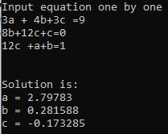
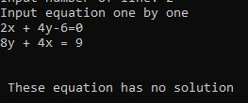
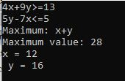
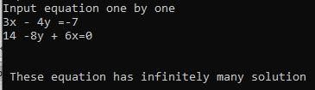
Output
Linear algebra
Linear programming

Slide 8

What are the challenges?
Separate variable and number
Create matrix from equations
Implementing simplex algorithm

Slide 9
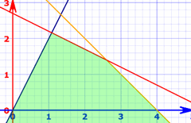
In future
Graphical view of linear programming (only 2D dimention)
Try to find real and rational solutions of the polynomial equation.
Create short equations when there are infinitely many solutions.
Implement the Big M method algorithm for linear programming.
Save history for future use

Slide 10

Tools used
Language: C++
Github link: https://github.com/mdSakibAlHasan/SPL-1

Slide 11
Thank You

